Slide 1

Predicting the Risk of Attaining Breast Cancer
A Project by
Flame Empire

Slide 2
Outline
Female Breast Anatomy
Breast Cancer
What should be the Approach
Mammography
Predicting the Risk of Attaining Breast Cancer
/*Please don’t mind the long Presentation. All I want is to make people know about how bad Breast Cancer is and why is it a matter of great concern. You can directly click on the links to reach the page you want to. Out Project is the 5th Member of Outline.*/

Slide 3
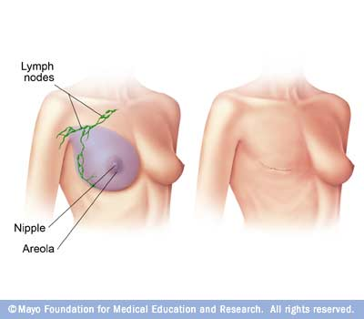
Breast Cancer
Breast cancer is the most common form of cancer in women, accounting for 14% of all cancers in Indian women.
According to estimates, an Indian woman is diagnosed with breast cancer every four minutes. Breast cancer is becoming more prevalent in both rural and urban India.
According to a 2018 study on breast cancer data, there were 1,62,468 new cases registered and 87,090 deaths confirmed.
Quick Link:
What should be the Approach

Slide 4
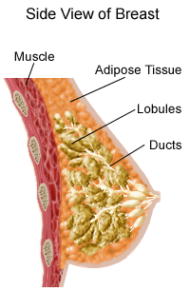
Muscles
Muscles
underneath
the breasts
separating them
from the ribs
Breast has
no
muscle tissue

Slide 5
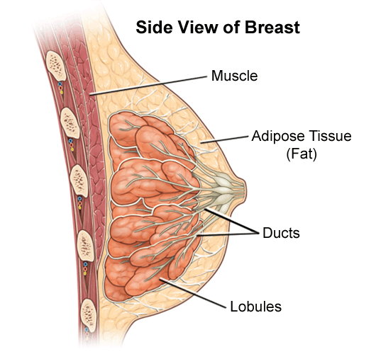
Female Breast Anatomy
Breasts consist mainly of fatty tissue interspersed with connective tissue
There are also less conspicuous parts
lobes
ducts
lymph nodes

Slide 6
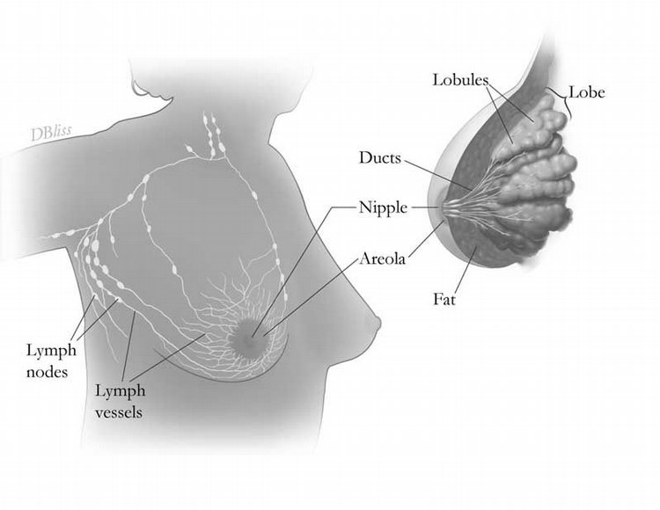
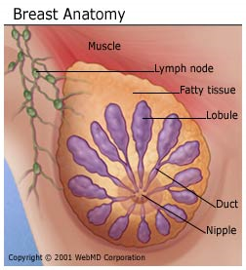

Breast Gland
Each breast has 15 to 20 sections (lobes) arranged like the petals of daisy
Inside each lobe are many smaller structures called lobules
At the end of each lobule are tiny sacs (bulbs) that can produce milk

Slide 7
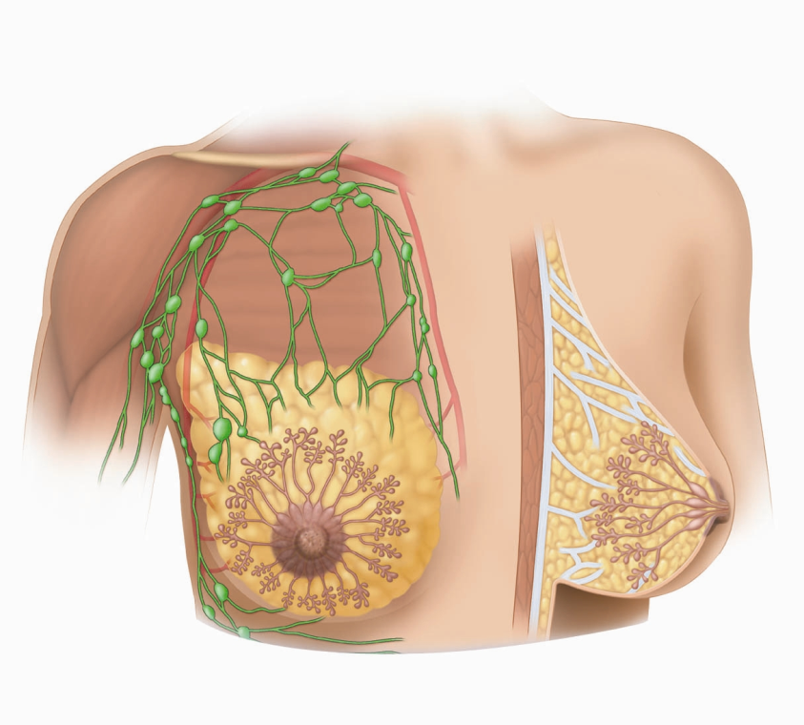
Ducts
2
1
Ducts carry
milk from bulbs
toward dark area
of skin in the
center of the
breast (areola)
Lobes, lobules,
and bulbs are
Linked by a
network of thin
tubes (ducts)
Ducts join together
into larger ducts ending
at the nipple, where
milk is delivered
Areola
3

Slide 8
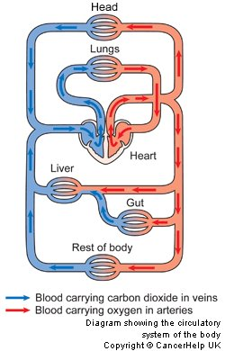
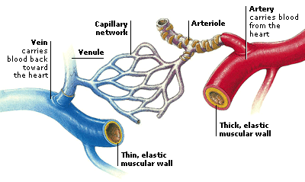
Blood Vessels
Oxygen, nutrients, and other life-sustaining nourishment are delivered to breast tissue by the blood in the arteries and capillaries.

Slide 9

Lymphatic System
Lymph ducts: Drain fluid that carries white blood cells (that fight disease) from the breast tissues into lymph nodes under the armpit and behind the breastbone
Lymph nodes: Filter harmful bacteria and play a key role in fighting off infection
Lymph node
Lymph duct
A network of vessels

Slide 10
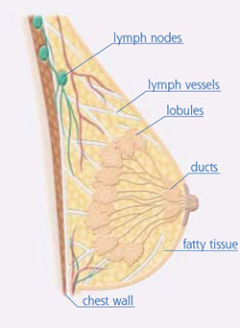
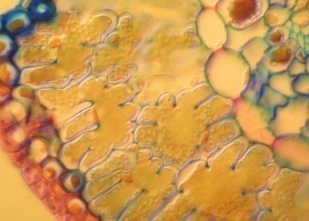

Three Types of Vessels
1
Lobules
Ducts
Nipple
Milk
3
Lymph
Nodes
Lymph
Vessels
Waste products
Bacteria
2
Blood
Vessels
Nourishment
Cell life

Slide 11
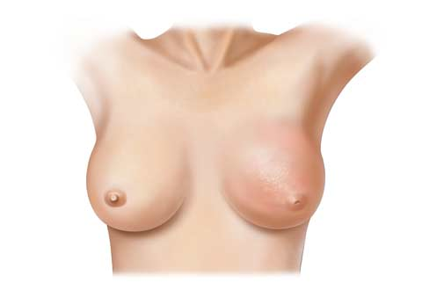
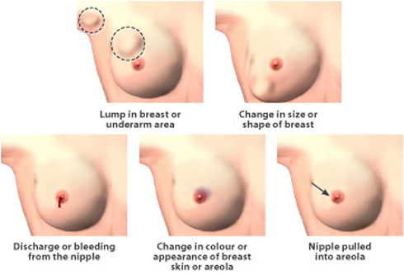
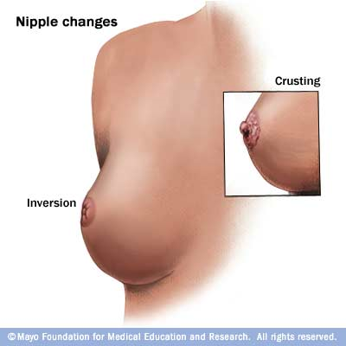
Signs and Symptoms
Most common: lump or thickening in breast. Often painless
Discharge or bleeding
Redness or pitting of skin over the breast, like the skin of an orange
Change in size or contours of breast
Change in color or appearance of areola

Slide 12
Noncancerous Conditions (1)
Fibrocystic changes: Lumpiness, thickening and swelling, often associated with a woman’s period
Cysts: Fluid-filled lumps can range from very tiny to about the size of an egg
Fibroadenomas: A solid, round, rubbery lump that moves under skin when touched, occuring most in young women
Infections: The breast will likely be red, warm, tender and lumpy
Trauma: a blow to the breast or a bruise can cause a lump

Slide 13
Noncancerous Conditions (2)
Microcalcifications: Tiny deposits of calcium can appear anywhere in a breast and often show up on a mammogram
Most women have one or more areas of microcalcifications of various sizes
Majority of calcium deposits are harmless
A small percentage may be precancerous or cancer (biopsy is sometimes recommended)

Slide 14
Causes
Some of the cells begin growing abnormally
These cells divide more rapidly than healthy cells do and may spread through the breast, to the lymph or to other parts of the body (metastasize)
The most common type of breast cancer begins in the milk-production ducts, but cancer may also occur in the lobules or in other breast tissue

Slide 15
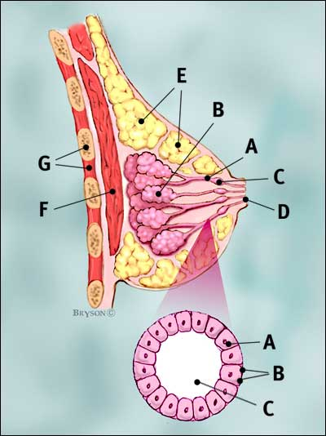
Normal Breast
Breast profile
A | ducts
B | lobules
C | dilated section of duct to hold milk
D | nipple
E | fat
F | pectoralis major muscle
G | chest wall/rib cage
Enlargement
A | normal duct cells
B | basement membrane (duct wall)
C | lumen (center of duct)
Illustration © Mary K. Bryson

Slide 16
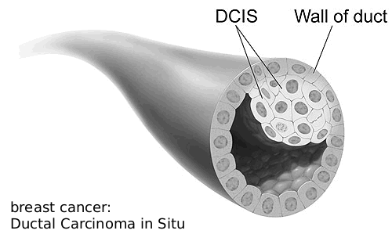
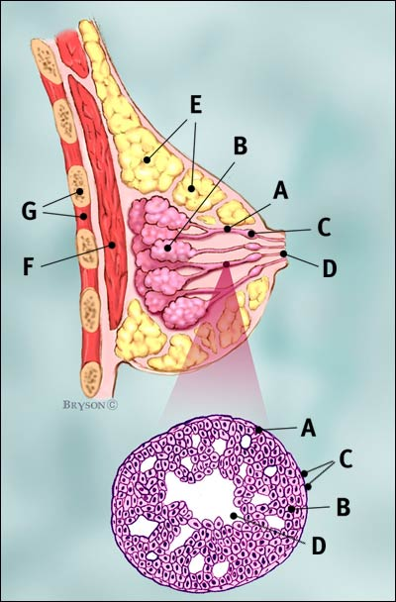
Ductal Carcinoma in situ (DCIS)
Ductal cancer cells
Normal ductal cell
Carcinoma refers to any cancer that begins in the skin or other tissues that cover internal organs
Illustration © Mary K. Bryson

Slide 17
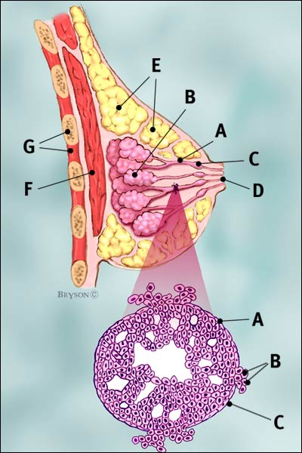
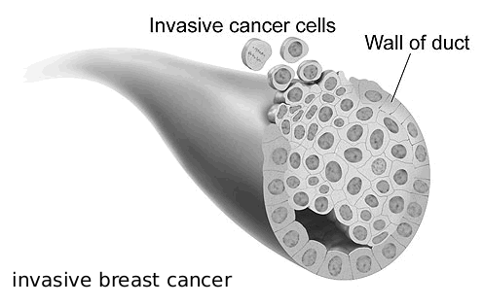
Invasive Ductal Carcinoma (IDC – 80% of breast cancer)
Ductal cancer cells breaking through the wall
The cancer has spread to the surrounding tissues
Illustration © Mary K. Bryson

Slide 18
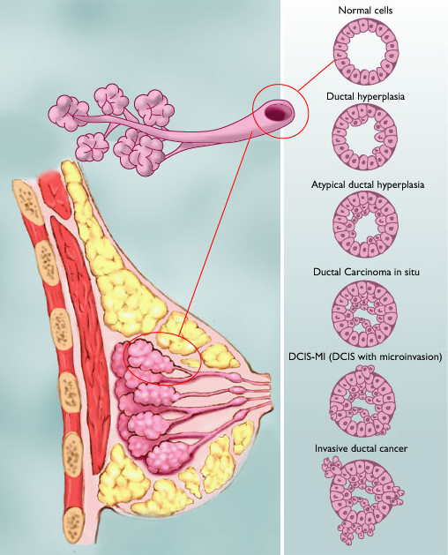
Range of Ductal Carcinoma in situ
Illustration © Mary K. Bryson

Slide 19
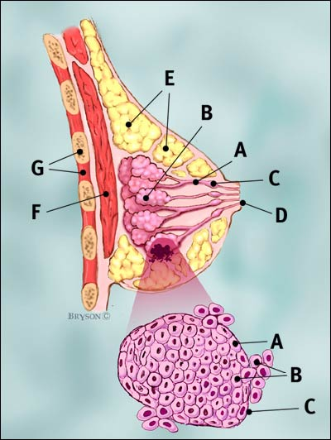
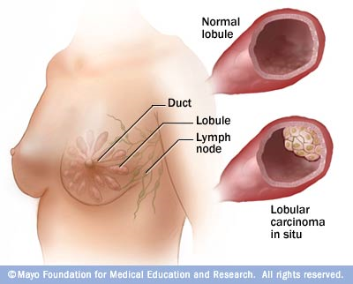
Invasive Lobular Carcinoma (ILC)
Lobular cancer cells breaking through the wall
Illustration © Mary K. Bryson

Slide 20
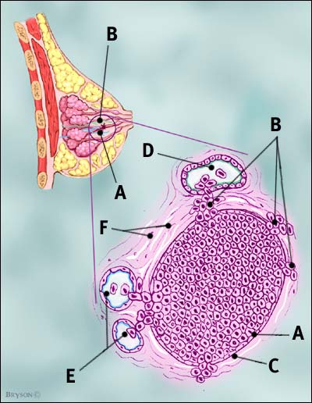
Cancer Can also Invade Lymph or Blood Vessels
Cancer cells invade lymph duct
Cancer cells invade blood vessel
Illustration © Mary K. Bryson

Slide 21

What should be the Approach
Bringing together everyone affected by the disease and all those working to stop it:
Supporting researchers
Host helplines, support groups and more for all affected by breast cancer
Public health campaigns that reach millions
Hard-hitting policy work and campaigning on behalf of patients and their families
Quick Link:
Predicting the Risk of Attaining Breast Cancer
Notes:
Presenter
2019-06-04 14:04:53
--------------------------------------------
Breast Cancer Now is the charity for all those affected by breast cancer, and all those working to end it. And together, we will do whatever it takes to create a world where everyone who develops breast cancer will live, and receive the support they need to live well.

Slide 22
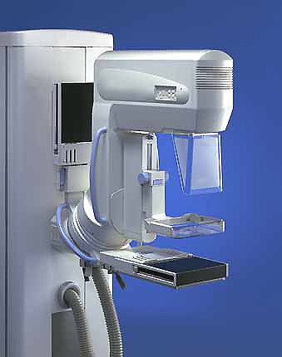
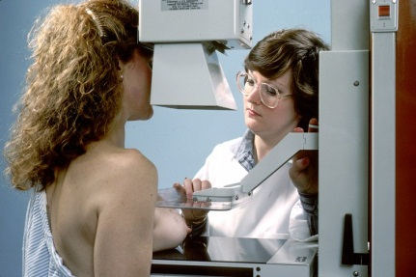
Mammography
Use a low-dose x-ray system to examine breasts
Digital mammography replaces x-ray film by solid-state detectors that convert x-rays into electrical signals. These signals are used to produce images that can be displayed on a computer screen (similar to digital cameras)
Mammography can show changes in the breast up to two years before a physician can feel them

Slide 23
Computer-Aided Diagnosis
Mammography allows for efficient diagnosis of breast cancers at an earlier stage
Radiologists misdiagnose 10-30% of the malignant cases
Of the cases sent for surgical biopsy, only 10-20% are actually malignant
CAD systems
can assist
radiologists to
Reduce these
problems
National Cancer Institute

Slide 24
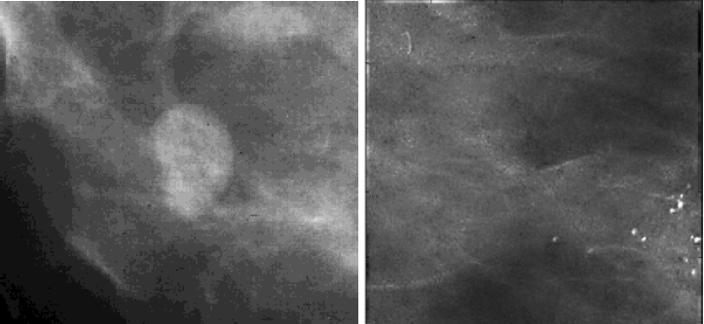
What Mammograms Show
Two of the most important mammographic indicators of breat cancers
Masses
Microcalcifications: Tiny flecks of calcium – like grains of salt – in the soft tissue of the breast that can sometimes indicate an early cancer.

Slide 25
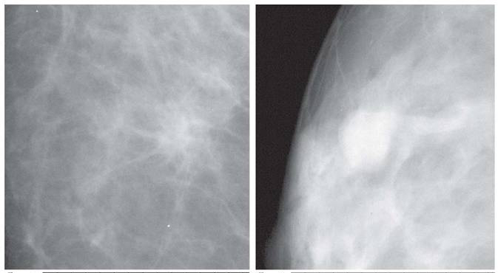
Detection of Malignant Masses
Malignant masses have a more spiculated appearance
benign
malignant

Slide 26
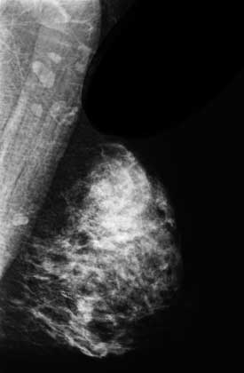
Mammogram – Difficult Case
Heterogeneously dense breast
Cancer can be difficult to detect with this type of breast tissue
The fibroglandular tissue (white areas) may hide the tumor
The breasts of younger women contain more glands and ligaments resulting in dense breast tissue

Slide 27
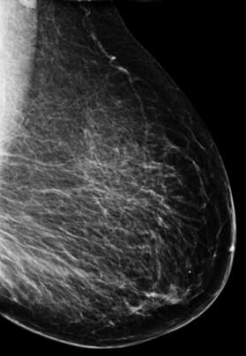
Mammogram – Easier Case
With age, breast tissue becomes fattier and has fewer glands
Cancer is relatively easy to detect in this type of breast tissue

Slide 28
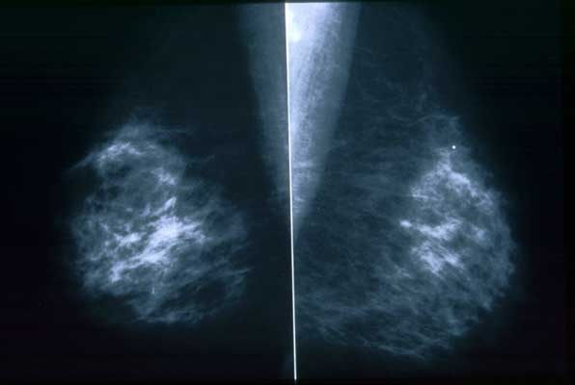
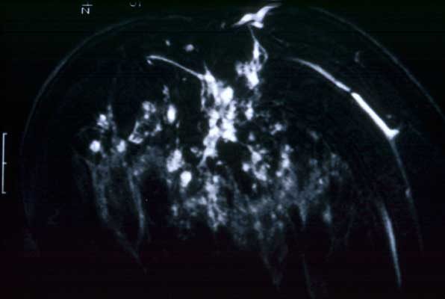
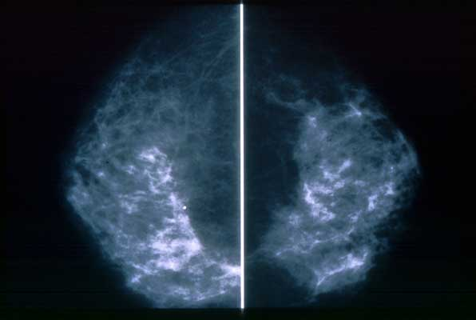
Different Views
Side-to-Side
MRI - Cancer can have a unique
appearance – many small irregular
white areas that turned out to be
cancer (used for diagnosis)
Top-to-Bottom

Slide 29

Scalar Field
A scalar field is a n-dimensional space with a scalar value attached to each point in the space (e.g., a gray-scale image)

Slide 30
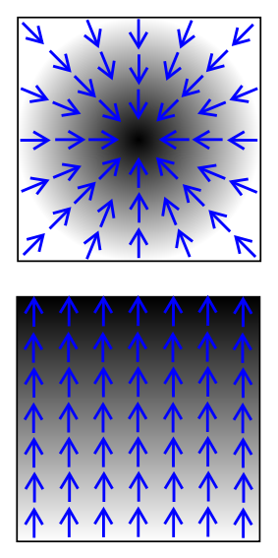
Scalar Field and Gradient
Black representing
Higher values
A scalar field is a n-dimensional space with a scalar value attached to each point in the space (e.g., a gray-scale image)
The derivative of a scalar field results in a vector field called the gradient
i.e., the gradient is a vector field
which points in the direction of the greatest rate of increase of the scalar field, and
whose magnitude is the greatest rate of change

Slide 31
Gradient
Black representing
Higher values
The derivative of a scalar field results in a vector field called the gradient
i.e., the gradient is a vector field
which points in the direction of the greatest rate of increase of the scalar field, and
whose magnitude is the greatest rate of change

Slide 32
Cartesian Gradient
For an image function I(P) where P is a pixel, the Cartesian gradient at P is:
P
Orientation:
Magnitude:

Slide 33
Radial Gradient
Radial gradient
The radial gradient vector has the same magnitude as the Cartesian gradient vector, but
the orientation is given as:
P

Slide 34
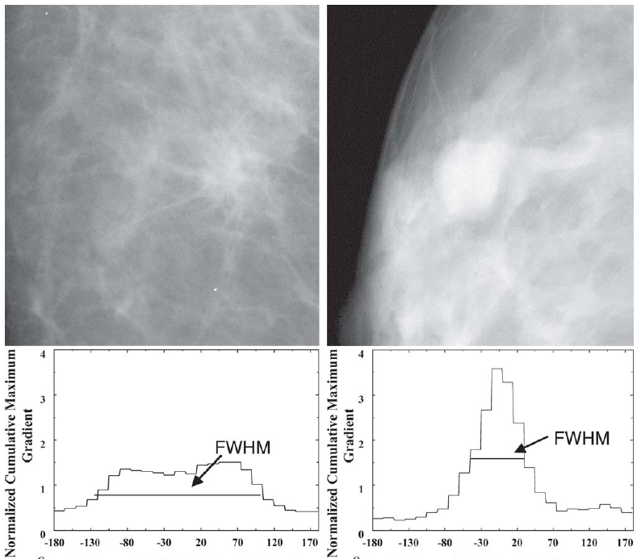
Feature: Spiculation [Huo et al.]
Extract the mass using a region-growing technique
The maximum gradient and its angle relative to the radial direction are computed
Calculate the full-width at half-maximum (FWHM) from the cumulative gradient orientation histogram

Slide 35
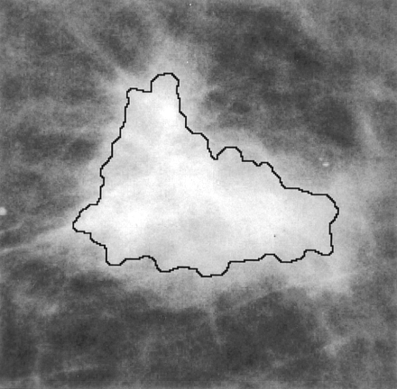
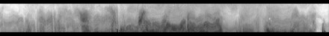
Feature: Spiculation [Chan et al.]
Determine the outline of the segmented mass
Obtain the rubber-band-straightening-transformed image
The spicules become approximately aligned in a similar direction
The rectangular region can then be subjected to texture analysis

Slide 36
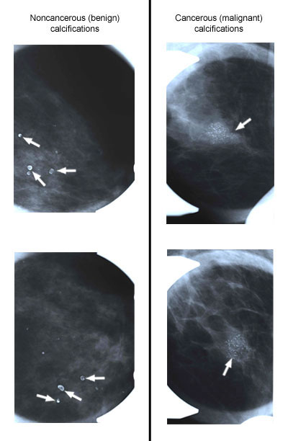
Breast Calcifications
Calcifications show up as white spots on a mammogram
Round well-defined, larger calcifications (left column) are more likely benign
Tight cluster of tiny, irregularly shaped calcifications (right column) may indicate cancer

Slide 37
Calcification Features
The morphology of individual calcification, e.g., shape, area, and brightness
The heterogeneity of individual features characterized by the mean, the standard deviation, and the maximum value for each feature.
Cluster features such as total area, compactness

Slide 38
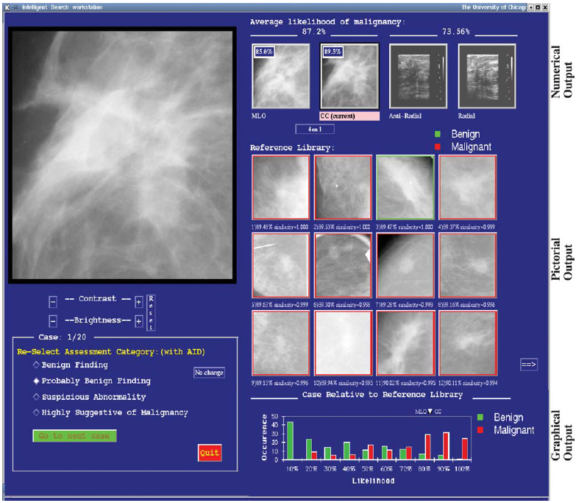
A Mammography CAD System [Giger et al.]
Probability of
malignancy
Similar images of
known diagnosis
Indicates the unknown
lesion relative to all
lesions in the database

Slide 39

Project: Predicting the Risk of Breast Cancer
Predicting the Risk of Breast Cancer is a tool for estimating the prospect of developing carcinoma . Using this tool, a user can enter some information including age, weight, height, history of carcinoma in 1st degree relative, age of a user at the primary birth or nulliparity, menopausal status, history of previous breast biopsy, and history of using hormone replacement therapy. Then, the app will return the prospect of developing Cancer . Upon returning of the result, the tool also provides additional insights about carcinoma from the dataset.

Slide 40
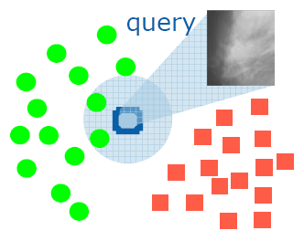
Database Approach to Computer-Aided Diagnosis
Content-based image retrieval techniques can provide radiologists “visual aids” to increase confidence in their diagnosis
The database consists of a large number of images with verified pathology results
Diagnosis is done by submitting the suspected mass region as a query to retrieve similar cases from the database

Slide 41
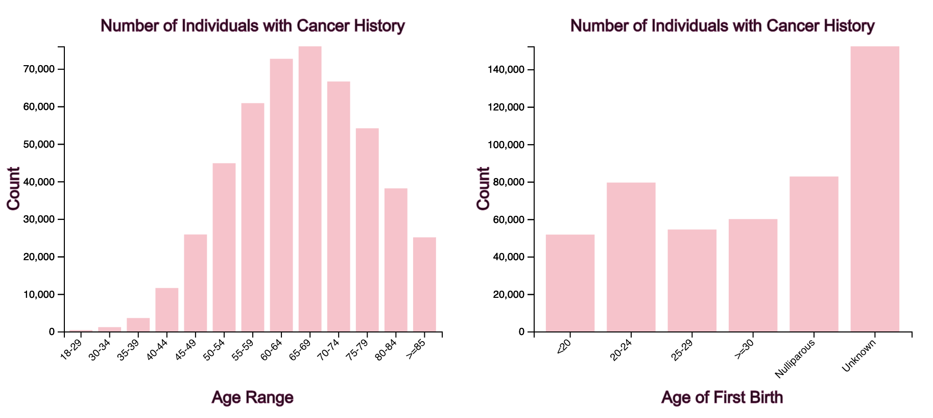
Data Analysis
The information was gathered from the website of the Breast Cancer Surveillance Consortium (BCSC). A random forest model was trained as a classifier after data wrangling and feature engineering measures. Precision and recall were used to fine-tune and evaluate results. In order to build the project HTML, CSS, Python, Flask & D3.js were used.

Slide 42
The Future of our Project
Class 1: In the class 1 Stage of our project we are working on an average PRABC Tool. (Code Innovation Series - Gurunanak Institute Of Technology 2021)
Class 2: In the class 2 Stage of our project we will be working on DHE: Daily Human Evaluation for both Equivocal and Negative. A community based network monitoring.
Class 3: We want to expand our work in terms of Machine Science where we will want to involve our Data Hand’s in Hospitals.
Class 4: Project C4Carcinomia at this point we will be involving higher degree Processing for greater understanding and completely obliteration of Carcinoma.
At the end in order for achieving. What seems to be an impossible dream. For this project we had to read several research articles. And we won’t stop until we achieve it.

Slide 43





Slide 44


Slide 45

THE END

